Slide 1

Targeted Marketing Plan
Harsha Bhatia
Vikram Bhattacharjee

Slide 2
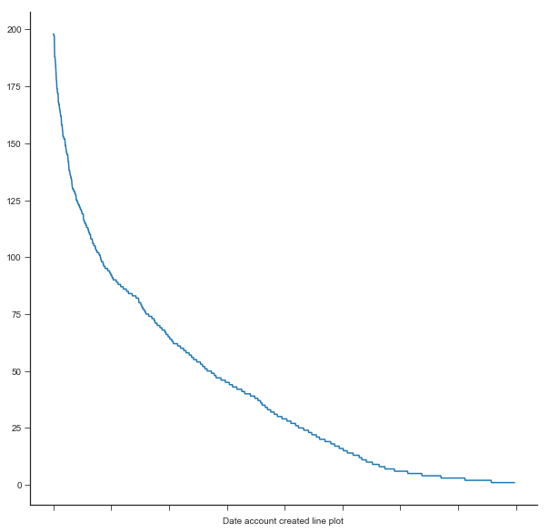
Decline in new user signups?
Number of new user signups is reducing
How can we mitigate this?

Slide 3
The Challenge
DATA
ANALYSIS
Sign up Methods
Booking information
Individual device choices
Demographics
Popular Signup Methods
Demographic based preferences
Popular Destinations
Provide AirBnB with a targeted marketing plan

Slide 4
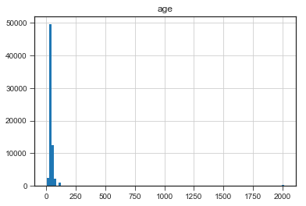
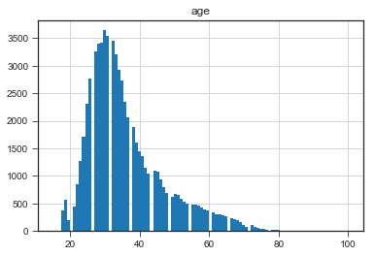
How accurate is my Data?
2% False Reporting
1325/68171 > 100
10 < 10
Enforce account linking or verification to mitigate incorrect data

Slide 5
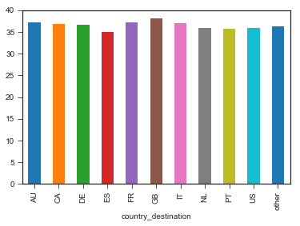
Holiday preferences based on age
Youngsters prefer Spain and Portugal
Older customers prefer Great Britain and France
Offer deals and preferences for locations based on age to popularize service

Slide 6
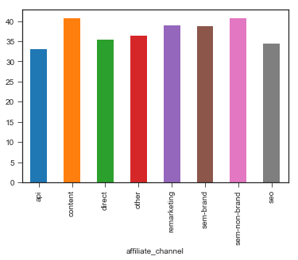
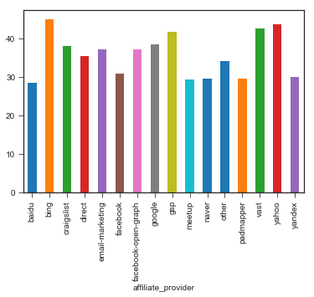
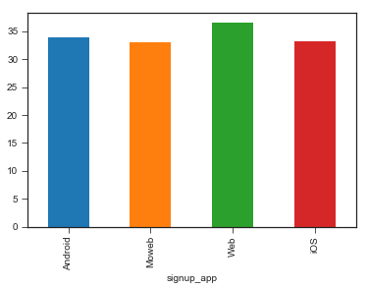
Which platforms to target?
AGE
Youngsters prefer Mobile Devices through Baidu, Meetup, Facebook → API based and SEO marketing techniques
Old prefer traditional web based browsers → Content based marketing techniques
Promote different destinations on different platforms

Slide 7
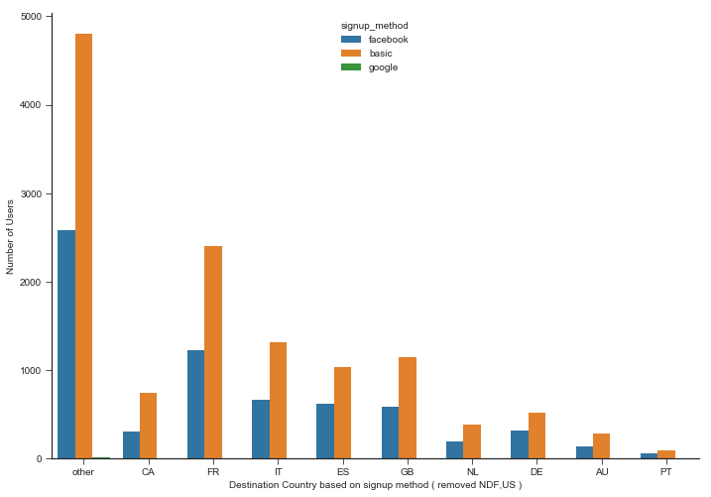
Which are the most popular destinations?
Native Airbnb App is most popular, followed by Facebook for signing up at AirBnB
France is the most popular and Portugal is the least popular destination
Promote Portugal on Facebook for shorter stays, Canada and AU for longer stays

Slide 8
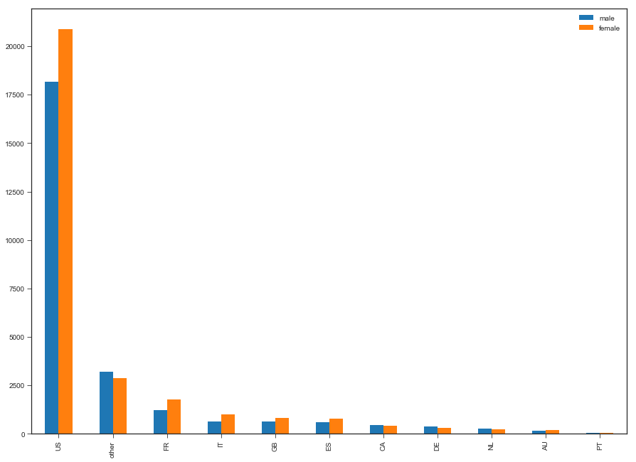
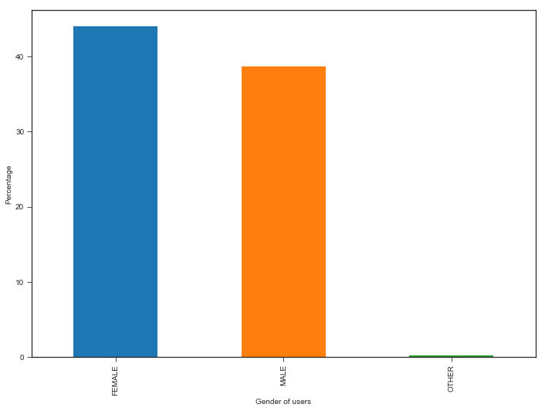
What about gender?
Not many customers comfortable stating gender
More women prefer to holiday?
GENDER
No. of bookings is directly proportional to the number of women travellers
Verify hosts and listings and make them appear more secure

Slide 9
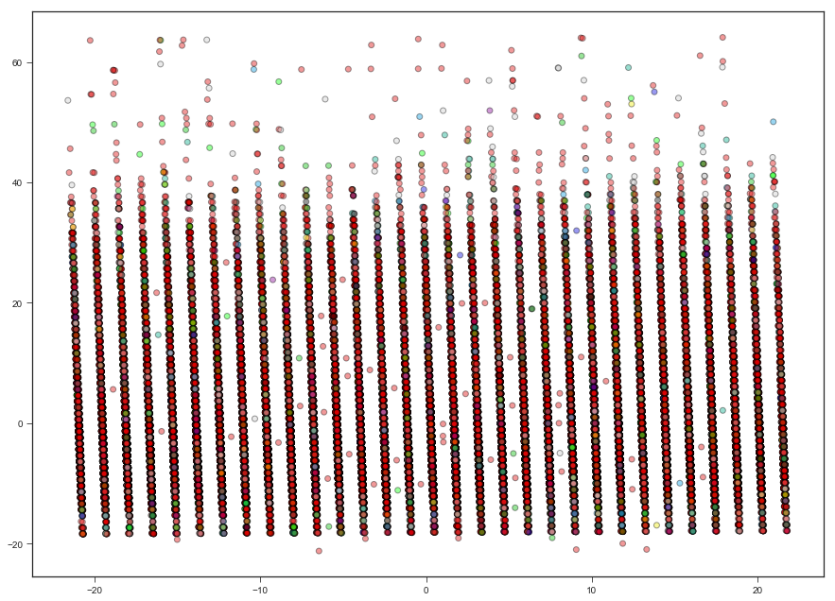
Which features are more important?
Perform Word2Vec: Convert language features to numerical representation
Perform PCA:
age date_day Timestamp_day
first_affiliate_tracked_omg affiliate_provider_google
Utilized PCA to identify important features

Slide 10
Multivariate Logistic Regression Analysis
precision recall f1-score support AU 1.00 1.00 1.00 47396 CA 0.00 0.00 0.00 7393 DE 0.00 0.00 0.00 1048 ES 0.00 0.00 0.00 3628 FR 0.10 1.00 0.18 1981 GB 0.00 0.00 0.00 1665 IT 0.00 0.00 0.00 1732 NL 0.00 0.00 0.00 588 PT 0.00 0.00 0.00 832 US 0.00 0.00 0.00 426 other 0.00 0.00 0.00 156 avg / total 0.71 0.74 0.71 66845
AU is identified with highest precision
The model is clearly able to predict all AU and FR bookings correctly
The bookings for AU are predicted to be highest
73.8% total identification accuracy achieved

Slide 11
Questions?

